Slide 1
Time Series Analysis & its Applications in Real-world.

Slide 2
Group Members
1. Supti Howlader Joya
Id- 17183103077
Intake- 39
2. Mrityunjoy Sen Gupta
Id- 17182103169
Intake-38
3. Basitur Rahman Bappi
Id- 17183103052
4. Rabbi Nur Muktar
Id- 17183103066
5. Shibdad Mahadi Shoumik
Id- 17182103047
Intake-38
Submitted To
Badhan Chandra Das
Lecturer
Department of Computer Science & Engineering

Slide 3
Introduction
The Series of data points recorded over a specified period of time is called Time-series data.
Time series analysis is a statistical method to analyse the past data within a given duration of time to forecast the future.

Slide 4
Importance of Time Series Analysis
Ample of time series data is being generated from a variety of fields. And hence the study time series analysis holds a lot of applications. Let us try to understand the importance of time series analysis in different areas.
Field of Economics
Field of Finance
Social Scientistà
Healthcare
Environmental Science
Sales forecasting

Slide 5
Why we need the Time Series Analysis?
Some of the main reasons for carrying out time series analysis can be concluded below:
Features
Forecasting
Inferences

Slide 6
Applications
Time Series Analysis is used for many applications such as:
Retail Sales
Time series forecasting
Medical Domain
Stock Prices
Weather
Heart Rate
Astronomy etc.

Slide 7
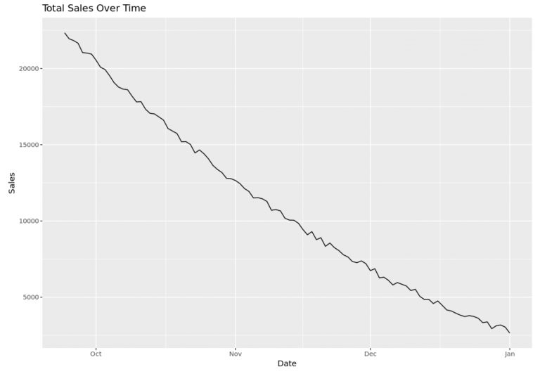
Retail Sales
Retail stores often use time series analysis to analyze how their total sales is trending over time.

Slide 8
Time series forecasting
Time series analysis assists companies in perceiving causes of fluctuations in trends or essential patterns over time, by using various data visualization techniques, organizations could study seasonal trends and research more to understand the causes of these trends.

Slide 9
Medical Domain
Medicine has evolved as a data-driven field and continues to contribute in time series analysis to human knowledge with enormous developments.

Slide 10
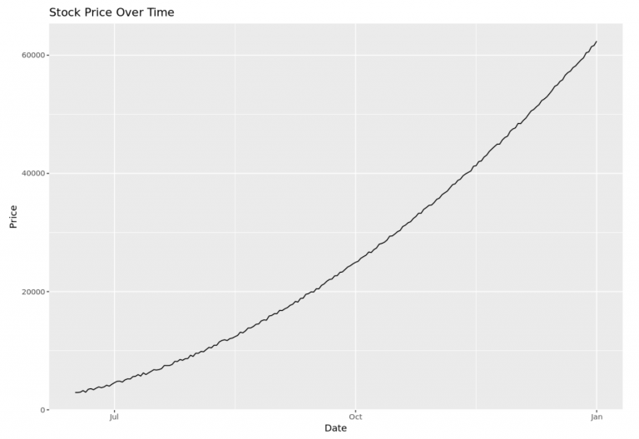
Stock Prices
Time series analysis is also used frequently by stock traders so they can gain a better understanding of the patterns in various stock prices.

Slide 11
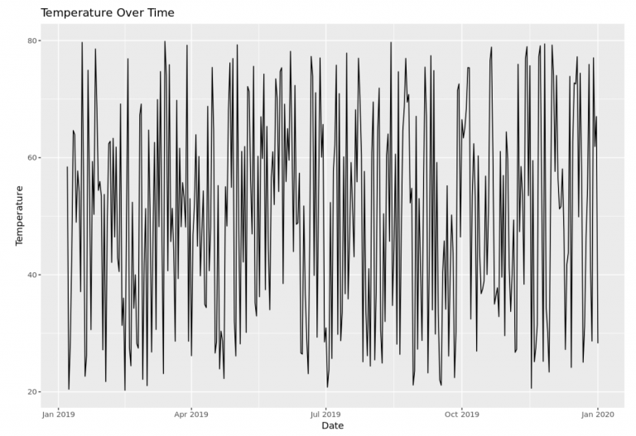
Weather
Time series analysis is also used frequently by weatherman to predict what the temperatures will be during different months and seasons throughout the year.

Slide 12
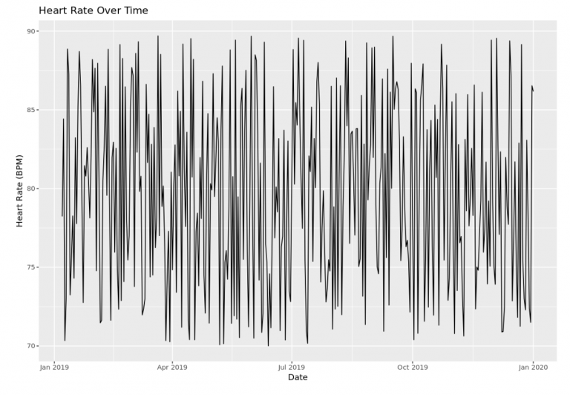
Heart Rate
Time series analysis is also used in the medical field to monitor the heart rate of patients who may be on certain medications to make sure that heart rate doesn’t fluctuate too wildly during any given time of the day.

Slide 13
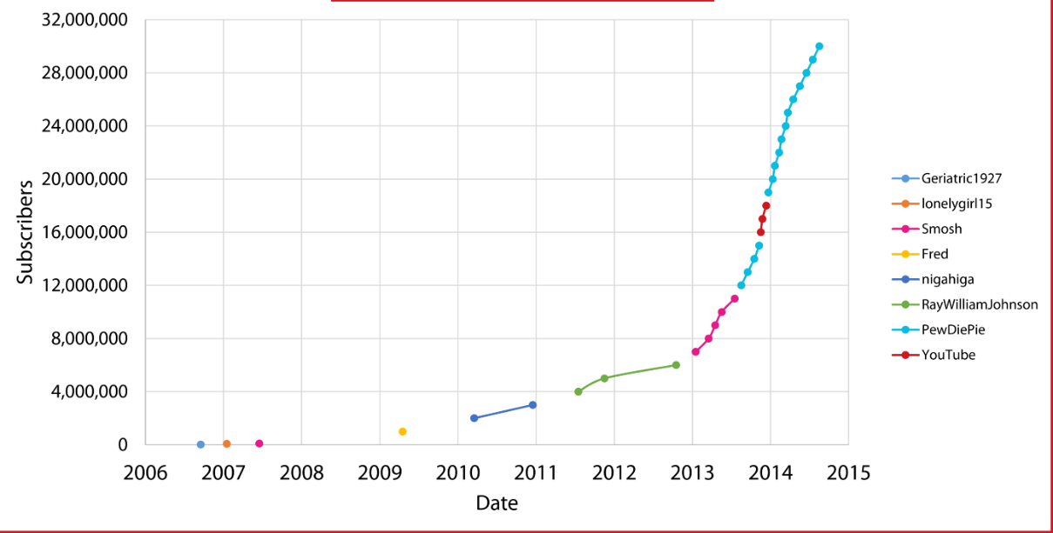
Subscribers
Time series analysis is often used by online publications to analyze trends in the total number of subscribers from one year to the next.

Slide 14
Financial and Business Domain
Most financial, investment and business decisions are taken into consideration on the basis of future changes and demands forecasts in the financial domain. Such as stock price movement or a company’s sales over the time,to analyze company’s performance Financial analysts use time series data such as stock price movements, or a company’s sales over time, to analyze a company’s performance
Time series analysis and forecasting essential processes for explaining the dynamic and influential behaviour of financial markets.

Slide 15
Astronomy
One of the contemporary and modern applications where time series plays a significant role are different areas of astronomy and astrophysics,
Being specific in its domain, astronomy hugely relies on plotting objects, trajectories and accurate measurements, and due to the same, astronomical experts are proficient in time series in calibrating instruments and studying objects of their interest.

Slide 16
Business Development
Time series forecasting helps businesses to make informed business decisions, as the process analyzes past data patterns it can be useful in forecasting future possibilities and events in the following ways
Reliability
Growth
Trend estimation
Seasonal patterns

Slide 17
Conclusion
The primitive decisions were made on the basis of gut feelings and common sense.
A systematic and collaborative approach to make a decision supported by the data is a real game-changer.

Slide 18
Reference
[1] Robert H. Shumway, David S. Stoffer, “Time Series Analysis and Its Applications”, Nov 2010, pp.1-46

Slide 19
Thank You

